Slide 1
Epileptic Seizure Recognition

Slide 2
Contents
Data Exploration
Cleaning and Sampling
Data Exploration Insights
ML Techniques

Slide 3
Data Exploration
Data set is composed of 11,500 samples of labeled EEG signal data.
Each sample consists of 179 time-series EEG signal readings for 1 second timeframe and 1 unused column (to be dropped).
Although the samples have 5 possible labels, for this project we are only considering 1=Seizure Activity, 0=Non-Seizure Activity.
There are 2,300 Seizure (1-label) records and 9,200 Non-Seizure (0-label) records.

Slide 4
Cleaning and Sampling
There are no missing values in this dataset, so no missing-data techniques are required
EEG signal data varies substantially in magnitude between Seizure and Non-Seizure samples so data normalization will be required.
Since the data set only has mild imbalance (2,900 out of 11,500 - 20% minority class), imbalanced dataset techniques will not be required.
Data set will be stratified split into 60% training, 20% validation and 20% test subsets.

Slide 5
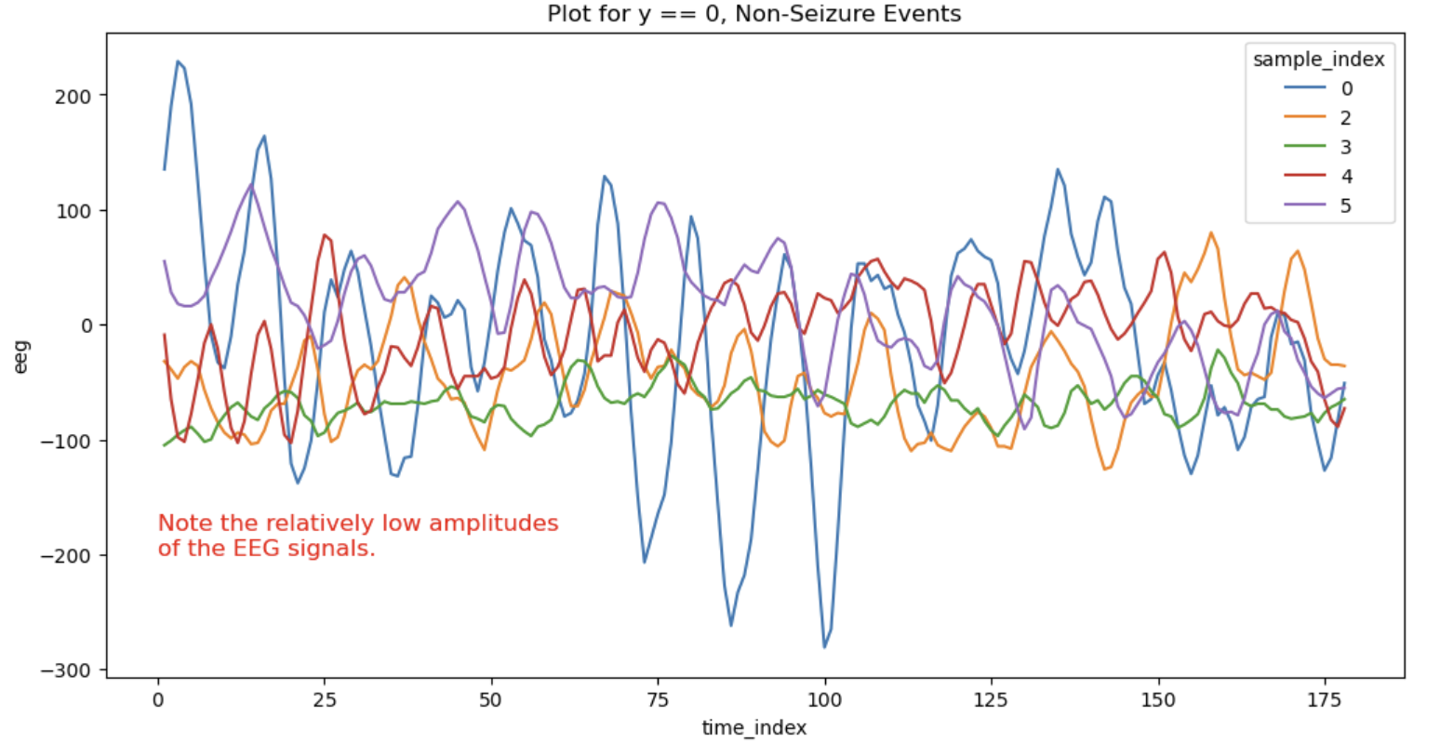
Data Exploration Insights
The following two plots show clear differences between the amplitudes of EEG signals for 5 samples of each category during a Non-Seizure and a Seizure recording event. These differences will be leveraged in the ML classification algorithms we employ.

Slide 6
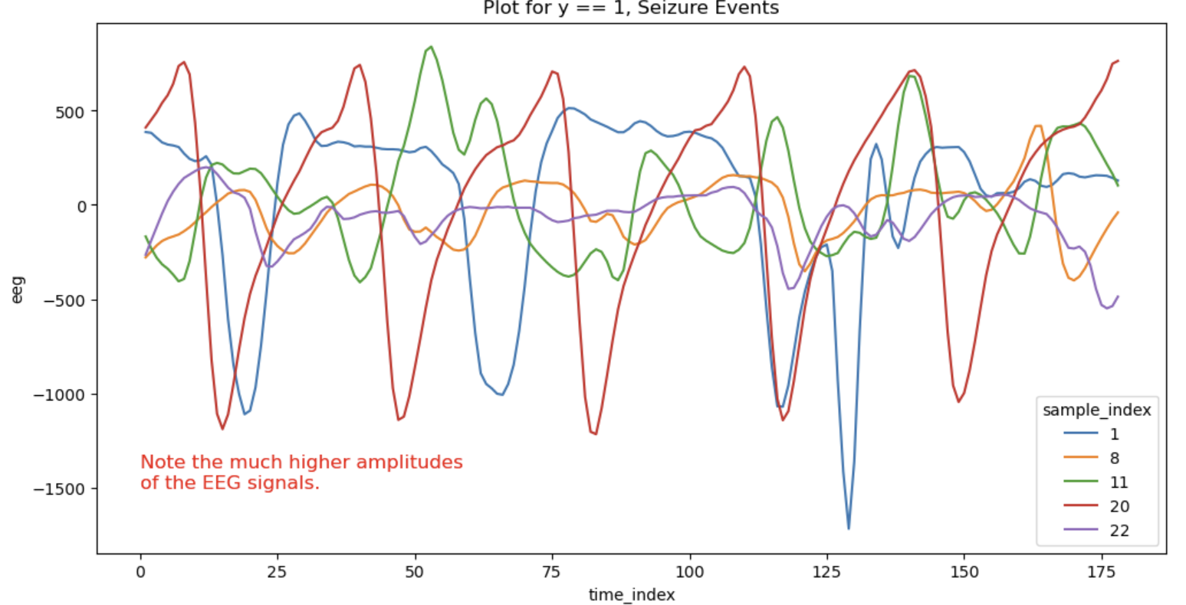
Data Exploration Insights
The plot below for Seizure event signals shows a much wider range of EEG amplitudes.

Slide 7
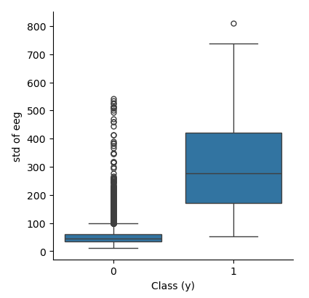
Data Exploration Insights
The box plot below shows the amplitude distribution of EEG signals during a Non-Seizure (left) and a Seizure recording (right). Clearly, the amplitude distributions are different, and this distinction will be exploited in the ML algorithms we choose.

Slide 8
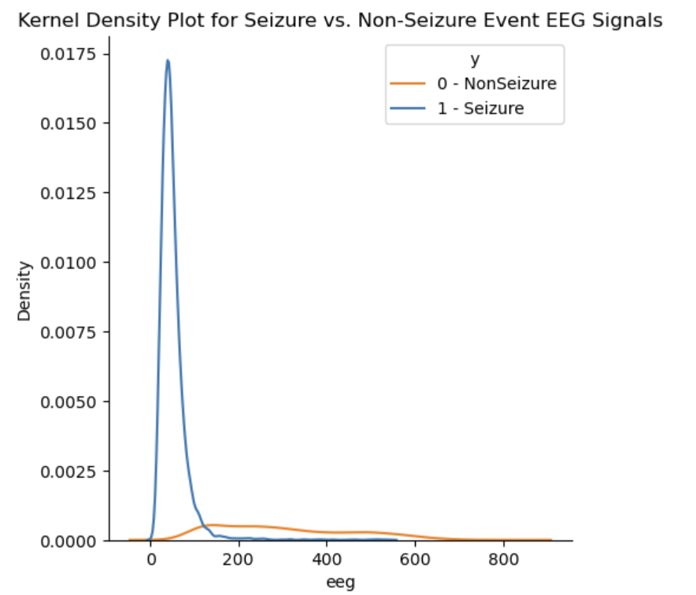
Data Exploration Insights
The kernel density plot below also shows the probability density function of the EEG signal amplitudes for the 2 classes. Clearly, Seizure events are marked are widely distributed and have a much wider range.

Slide 9
Machine Learning Algorithms
XGBoost – An optimized gradient boosting machine learning algorithm designed for speed and performance, often used for classification and regression tasks.
TabNet - A deep learning algorithm designed for tabular data that uses sequential attention to select features at each decision step, enabling interpretability and high performance on structured data tasks
Random Forest - An ensemble learning algorithm that constructs multiple decision trees during training and outputs the mode of their predictions for classification or the mean for regression tasks
1D-Convolutional Neural Network - A deep learning algorithm that applies convolutional operations to one-dimensional data, such as time series or sequences, to automatically learn and extract features for tasks like classification and regression.

